Slide 1

Applied Machine Learning for IoT
Hank Roark
13-April-2016
Data Science Pop-up Austin

Slide 2
WHO AMI I
Lead, Customer Data Science @ H2O.ai
John Deere: Research, Software Product Development, High Tech Ventures
Lots of time dealing with data off of machines, equipment, satellites, weather, radar, hand sampled, and on.
Geospatial, temporal / time series data almost all from sensors.
Systems Design and Management: MIT Physics: Georgia Tech
hank@h2o.ai @hankroark https://www.linkedin.com/in/hankroark

Slide 3
WHY IOT?
Because it’s trending (so it must be promising)!
Internet of Things
Deep Learning

Slide 4
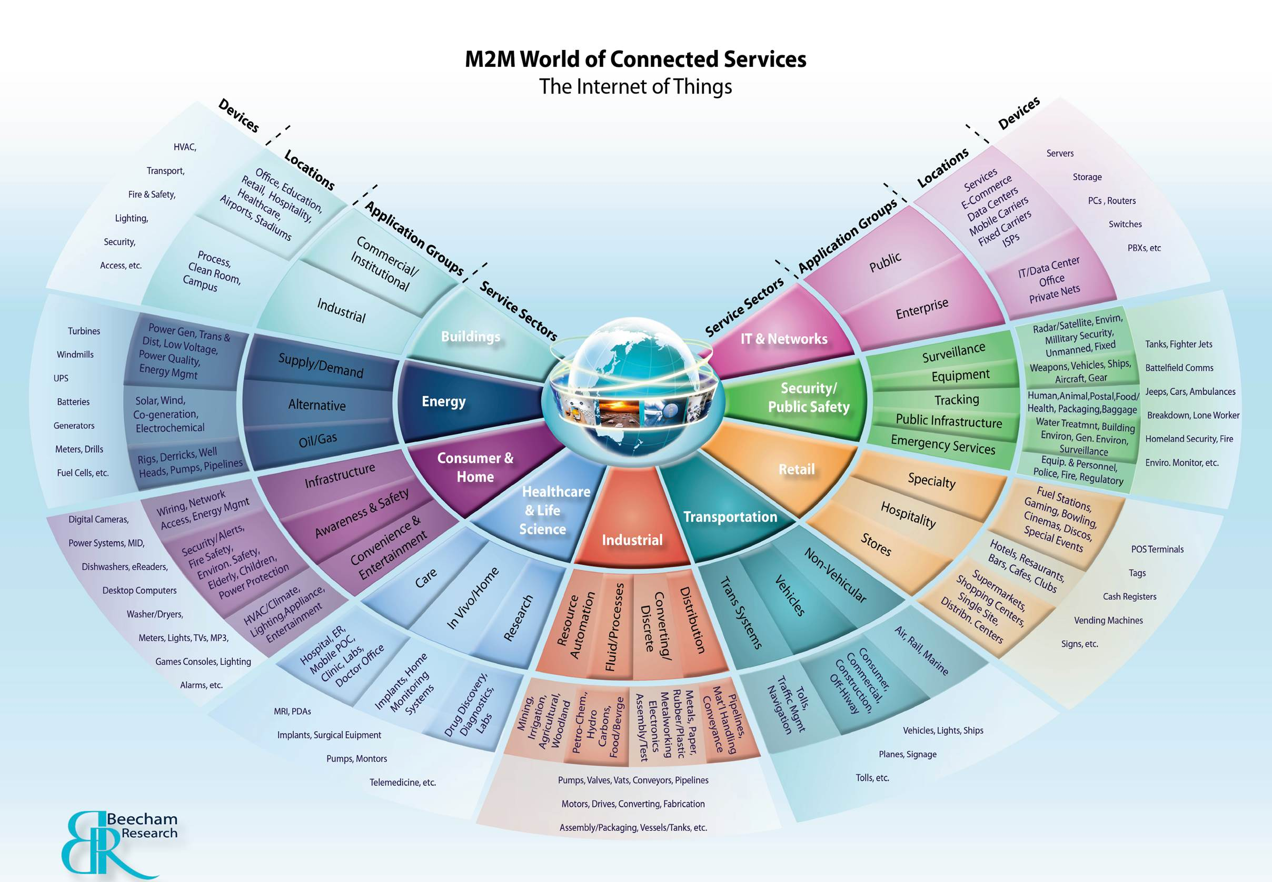
IF YOU ARE INTO DATA, THE IOT HAS IT

Slide 5
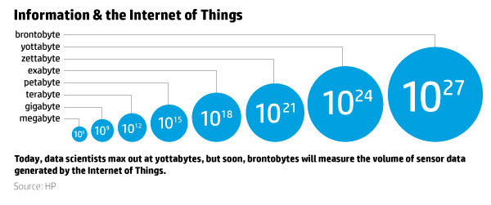
LOTS OF DATA

Slide 6
LOTS OF DATA
GET READY FOR BRONTOBYTES!!

Slide 7
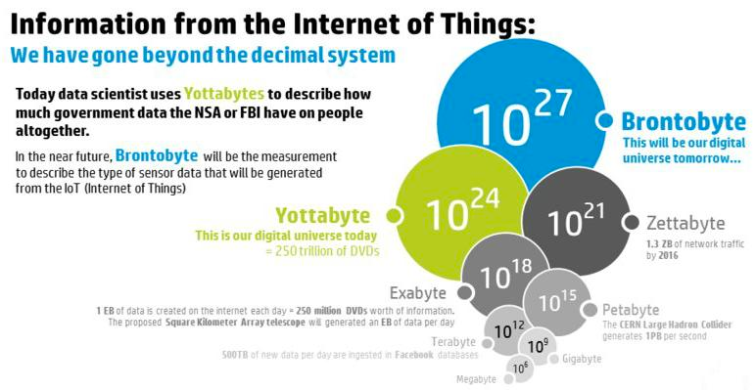
WOW, HOW BIG IS A BRONTOBYTE?

Slide 8
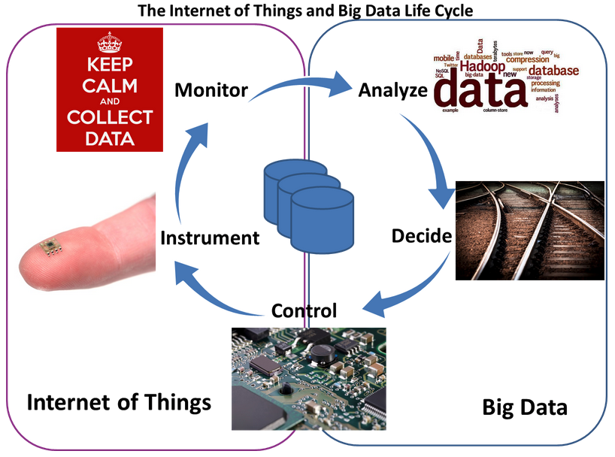
IOT ARCHITECTURE IS SETUP FOR REINFORCING, EXPONENTIAL GROWTH
Image courtesy http://www.telecom-cloud.net/wp-content/uploads/2015/05/Screen-Shot-2015-05-27-at-3.51.47-PM.png

Slide 9
MY PARTICULAR CURIOSITY

Slide 10
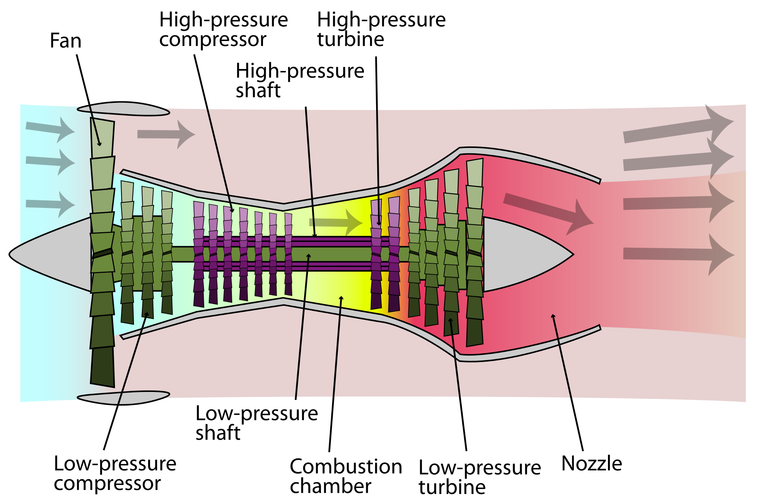
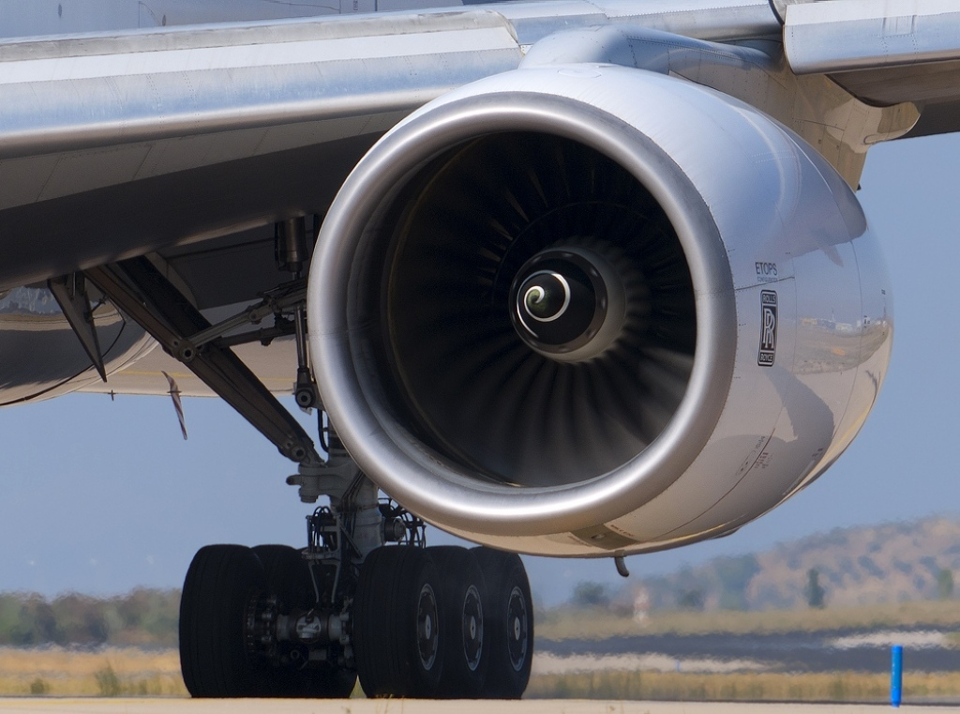
EXAMPLE FROM THE IOT
Domain: Prognostics and Health Management
Machine: Turbofan Jet Engines
Data Set: A. Saxena and K. Goebel (2008). "Turbofan Engine Degradation Simulation Data Set", NASA Ames Prognostics Data Repository
Predict Remaining Useful Life from Partial Life Runs
Six operating modes, two failure modes, manufacturing variability
Training: 249 jet engines run to failure
Test: 248 jet engines

Slide 11
SENSORS SHOW TRENDS OVERTIME
We also know remaining useful life decreases by at least one (1) cycle
each operation.
How can one take advantage of
this knowledge?
Time

Slide 12
INCORPORATING PRIOR STATE
One option:
Phase Space Embedding
Drawbacks:
Incorporates knowledge from only small number of prior states
Curse of dimensionality
Another parameter (tau)
Disentangling the dynamic core: a research program for a neurodynamics at the large-scale
MICHEL LE VAN QUYEN
Biol. Res. v.36 n.1 Santiago 2003
http://dx.doi.org/10.4067/S0716-97602003000100006

Slide 13
KALMAN FILTER
Notes:
Kalman filters take into account knowledge about all prior time steps predictions and measurement to calculate current state.
Builds on prior knowledge that remaining useful life should decrease by one each observed cycle.
Another way to think about Kalman filters: When state variable goes from being discrete to continuous, an hidden markov model (HMM) becomes a Kalman filter.
Widely used in engineering and economics

Slide 14
FINAL PIPELINE
Not really that much different than typical machine learning pipeline
Feature engineering
Signal processing, feature creation, feature selection (H2O)
Regression Models
Supervised Machine Learning (H2O)
Post Processing
Kalman filter (pykalman, in this case)
Notes:
Regression model - think of it as a non-linear mapping from high dimensional signal space to (lower dimensional) observation space (one per regression model)
Kalman filter acts as both incorporating prior knowledge (dynamics) and ensembling results from multiple regression models (aka observations)

Slide 15
BEFORE AND AFTER POST-PROCESSING
UNIT #2
UNIT #2
PREDICTED RUL
CYCLE NUMBER
CYCLE NUMBER
This presentation, data, and associated Jupyter notebooks (look in 2016_04_13_AppliedMachineLearningForIoT): https://github.com/h2oai/h2o-meetups/

Slide 16
FLEET TELEMATICS: PREVENTIVE MAINTENANCE
“Annual Savings are $7M”
– Anonymized, Member Technical Staff
Leading Mobile Telecom Operator
PROBLEM
Fleet telematics—analyze maintenance records and vehicle performance to make predictions on when to do preventive maintenance
Couldn’t scale by sampling data
Took days to create models
WHY H2O
H2O support for customer’s Kerberos authentication mechanism for Hadoop
Support for MapReduce, YARN, R, Python and Spark in Hadoop
In-memory, distributed architecture
Rapid deployment to production with POJO
Quick prototyping with H2O Flow
IMPACT
When you look at the cost of towing a stranded vehicle, technician loss of productivity, and the customer lifetime value, the annual savings is $7M.” – Anonymized, Lead Member Technical Staff
Telecommunications

Slide 17
TAKE-AWAYS
Know your “physics”
”Physics” is will be like a fish finder in this sea of Brontobytes
Linear dynamic systems, Queues, Signals, etc.
Big data and Big models and Small models
Keeping and eye on promising new methods (e.g., Convolution Neural Nets and LSTM-RNN)
Notes:
“Signal Processing is the science that deals with extraction of information from signals of various kinds. This has two distinct aspects -- characterization and categorization. Traditionally, signal characterization has been performed with mathematically-driven transforms, while categorization and classification are achieved using statistical tools
Machine learning aims to design algorithms that learn about the state of the world directly from data.
A increasingly popular trend has been to develop and apply machine learning techniques to both aspects of signal processing, often blurring the distinction between the two.”
http://mlsp.cs.cmu.edu/courses/fall2012/

Slide 18
H2O RESOURCES
Download and go: http://www.h2o.ai/download
Documentation: http://docs.h2o.ai/
Booklets, Datasheet: http://www.h2o.ai/resources/
Github: http://github.com/h2oai/
Training: http://learn.h2o.ai/

Slide 19
THANK YOU

